Slide 1
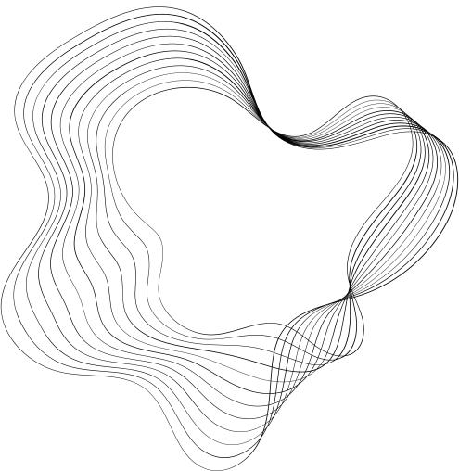

A Comparative Analysis of Object Detection and Tracking Algorithms in Vehicle Surveillance
BTECH MAJOR PROJECT REPORT
By
Shivansh (2K20/SE/129)
Susheet Mohan (2K20/SE/139)

Slide 2

CONTENT
01
INTRODUCTION
02
OVERVIEW
03
RELATED WORK / LITERATURE REVIEW
04
LITERATURE GAP & RESEARCH QUESTIONS
05
TIMELINE
06
RESULT
07
REFERENCES

Slide 3
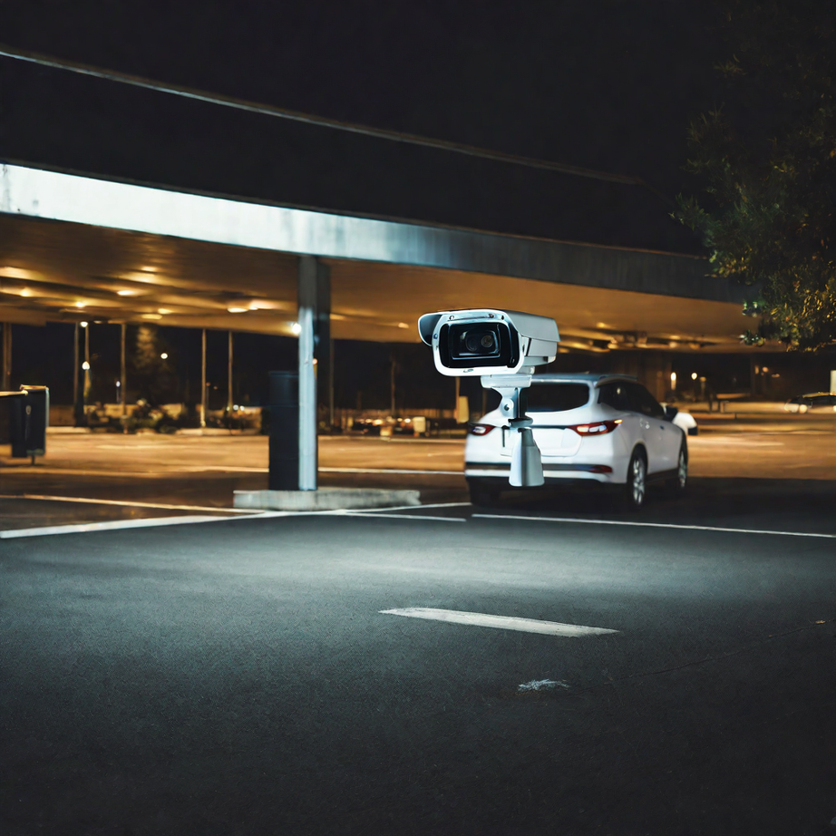
INTRODUCTION
Introduction to Smart Vehicle Surveillance:
With increasing concerns about security in transportation systems, the integration of advanced technologies like YOLO and DeepSORT offers a promising solution for real-time vehicle monitoring and surveillance.
Objective of the Research:
Primary Goal:
To identify the most effective object detector and tracker combination for vehicle counting.
Secondary Goals:
To evaluate performance under various environmental conditions (daylight, nighttime, rain).
To benchmark results against ground truth data obtained from manual vehicle counts.
To enhance the accuracy and reliability of vehicle surveillance systems through advanced algorithms.

Slide 4
INTRODUCTION
Object Detection Methods:
Definition: Techniques used to identify and locate objects within an image or video frame
YOLO (You Only Look Once):
Real-time object detection.
High accuracy and speed.
SSD (Single Shot MultiBox Detector):
Detects objects in a single pass.
Efficient for real-time applications.
SURF (Speeded-Up Robust Features):
Detects and describes local features in images.
Robust to changes in scale and rotation.
Object Tracking Methods:
Definition: Techniques used to monitor the movement of objects across consecutive frames in a video.
DeepSORT (Simple Online and Realtime Tracking):
Combines deep learning with a SORT tracker.
Accurate and reliable tracking of multiple objects.
RNN (Recurrent Neural Networks):
Utilizes sequential data for tracking.
Effective in predicting future positions of moving objects.

Slide 5





OVERVIEW
VMS
YOLO
DeepSORT
YOLO is a real-time object detection system that processes images or video frames and predicts bounding boxes and class labels for multiple objects simultaneously.It can quickly detect and track vehicles, providing enhanced security and situational awareness.
A vehicle monitoring and surveillance system is a powerful tool for enhancing security and safety in various environments. The purpose of implementing such a system is to monitor and track vehicles in real-time, detect suspicious activities, and provide valuable data for investigation and analysis
DeepSORT (Deep Learning for Object Tracking) is a state-of-the-art deep learning-based object tracking algorithm.
DeepSORT utilizes a combination of deep learning and tracking techniques to accurately track objects in a video stream.
DeepSORT plays a crucial role in the vehicle monitoring and surveillance system by providing real-time and accurate tracking of vehicles.

Slide 6
OVERVIEW
SSD
The Single Shot MultiBox Detector (SSD) is a state-of-the-art object detection algorithm optimized for real-time performance. It functions by predicting object classes and bounding boxes in one step, leveraging multiple feature maps at different resolutions. SSD's architecture integrates a base convolutional neural network with extra detection layers, achieving both high accuracy and speed. This design enables SSD to efficiently detect objects of various sizes.
SURF
RNN
SURF is a feature detection algorithm used to identify and describe key points in images, providing robust matching across different scales and rotations. It efficiently detects and tracks vehicles by recognizing unique image features, enhancing reliability and performance in various conditions.
RNN (Recurrent Neural Networks) is a cutting-edge neural network architecture designed for sequential data processing.
RNNs leverage their internal memory to capture temporal dependencies, making them ideal for time-series data analysis.
RNNs are essential in vehicle monitoring and surveillance systems by accurately predicting and tracking vehicle movements over time.

Slide 7

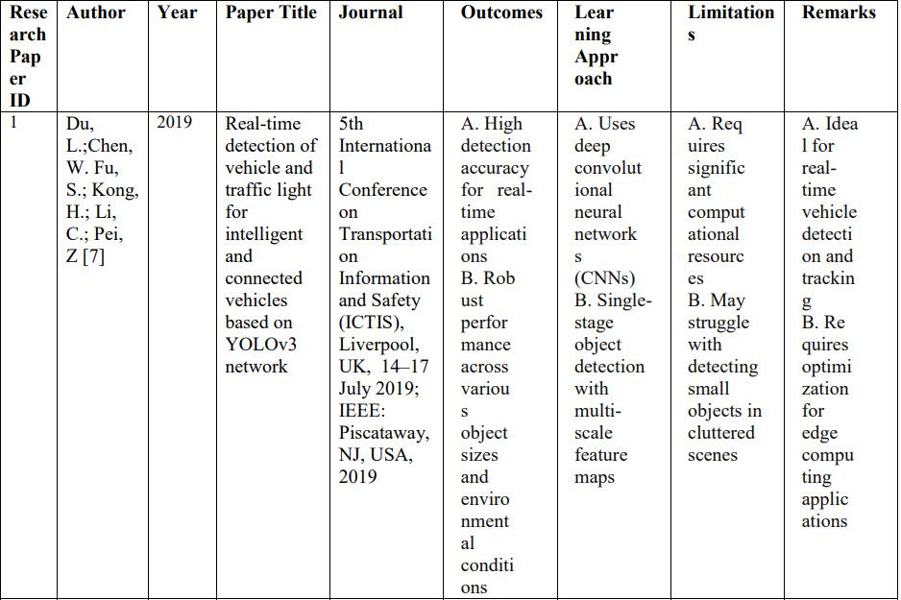
RELATED WORK
This review examines developments in the discipline, including the use of tools like YOLOv4, DeepSORT, RNN, SURF, and SSD. The goal is to identify gaps, constraints, and potential prospects for further growth by assessing various research publications. This literature review serves as a framework for the development of the machine learning-based model for vehicle counting and tracking in this project. The study articles are presented below, along with a comparison table between them based on their outcomes, learning approach, limitations, and remarks.

Slide 8
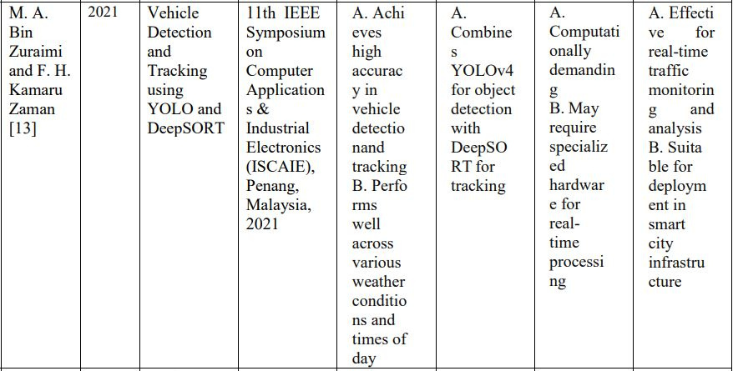
RELATED WORK

Slide 9
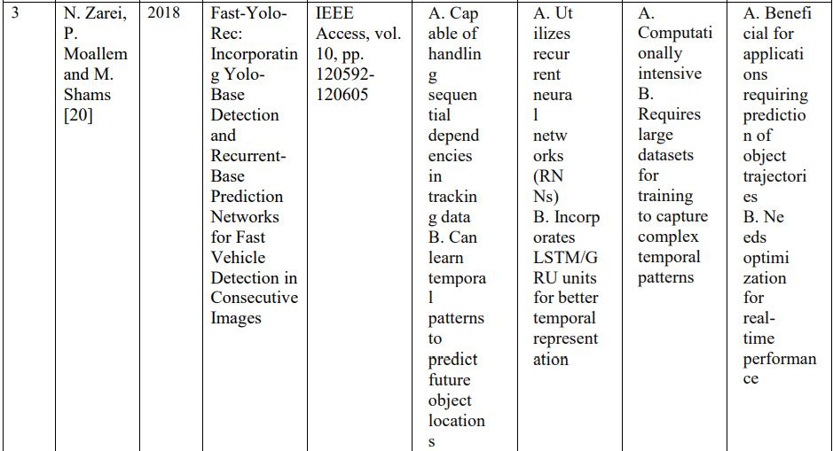
RELATED WORK

Slide 10
LITERATURE GAP
Despite significant advancements, several research gaps remain in object detection and tracking for vehicle counting. Addressing these is crucial for enhancing accuracy, efficiency, and real-world applicability.
Scalability and Real-Time Processing -
Challenge: High computational demand limits scalability in high-density traffic environments.
Future Focus: Develop efficient algorithms using model pruning, quantization, and optimized neural architectures.
2. Detection and Tracking in Adverse Conditions -
Challenge: Performance drops in rain, fog, and nighttime conditions.
Future Focus: Enhance models with additional sensor data (e.g., radar, LiDAR) and advanced
data augmentation technique.
3.Handling Occlusions and Small Objects -
Challenge: Difficulty in detecting partially obscured or small vehicles.
Future Focus: Implement multi-view camera systems and advanced feature extraction methods.
4.Generalization Across Different Environments -
Challenge: Models trained in specific conditions may not generalize well to new environments.
Future Focus: Utilize transfer learning and domain adaptation techniques for better adaptability.
5.Benchmarking and Standardization -
Challenge: Lack of standardized benchmarks for performance evaluation.
Future Focus: Develop standardized benchmarks and evaluation protocols for consistent and reliable comparisons.

Slide 11
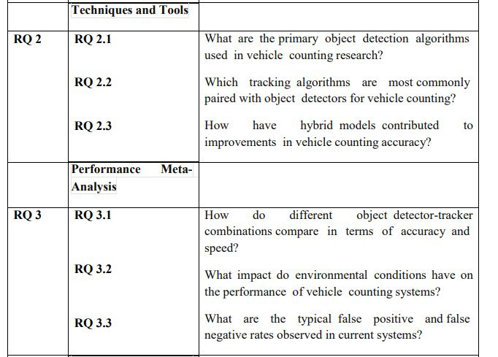
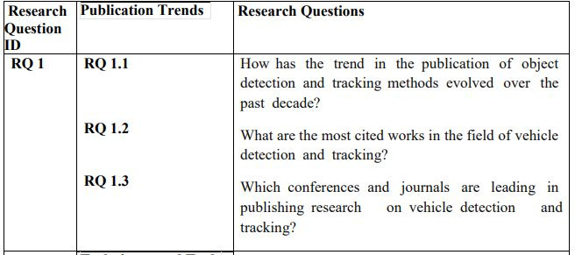
RESEARCH QUESTIONS
In this research, we pose several key questions to guide our investigation into the effectiveness of various object detection and tracking algorithms for vehicle surveillance, aiming to identify the best combination for accurate and reliable vehicle counting.

Slide 12
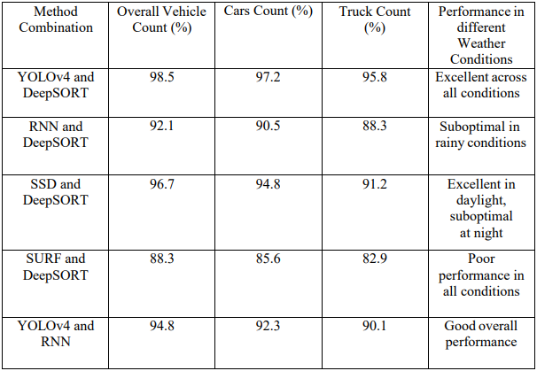
RESULT

Slide 13
RESULT
The performance evaluation of various hybrid model combinations under different weather conditions
reveals significant insights:
YOLOv4 and DeepSORT: Achieved the highest overall vehicle count accuracy (98.5%) and demonstrated excellent performance across all conditions, making it the most robust combination.
RNN and DeepSORT: While showing good overall performance (92.1%), this combination struggles in rainy conditions, affecting its reliability.
SSD and DeepSORT: Exhibited strong performance in daylight conditions (96.7%) but showed a decline at night, indicating a need for further improvement in low-light scenarios.
SURF and DeepSORT: Had the lowest performance across all metrics, with an overall vehicle count accuracy of 88.3%, making it unsuitable for reliable vehicle surveillance.
YOLOv4 and RNN: Delivered good overall performance (94.8%), but it still falls short compared to the YOLOv4 and DeepSORT combination.
These results highlight YOLOv4 and DeepSORT as the most effective combination for accurate and consistent vehicle counting in diverse weather conditions.

Slide 14
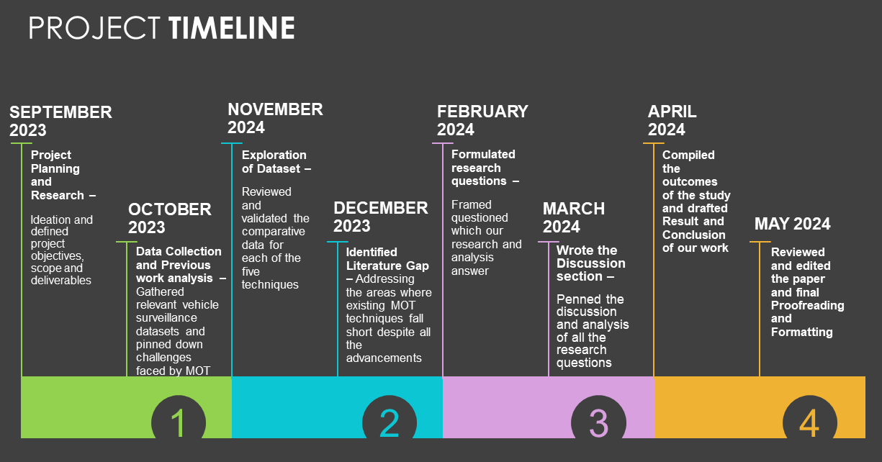

Slide 15
REFERENCES
[1] K. Smith, D. Gatica-Perez, J. Odobez and Sileye Ba, "Evaluating Multi-Object Tracking," 2005 IEEE Computer Society Conference on Computer Vision and Pattern Recognition (CVPR'05) - Workshops, San Diego, CA, USA, 2005, pp. 36-36, doi: 10.1109/CVPR.2005.453.
[2] H. Song, H. Liang, H. Li, Z. Dai, and X. Yun, ―Vision based vehicle detection and counting system using deep learning in highway scenes,‖ Eur. Transp. Res. Rev., vol. 11, no. 1, p. 51, Dec. 2019.
[3] Srivastava, S, Divekar, A.V, Anilkumar, C. et al. Comparative analysis of deep learning image detection algorithms.
[4] J. van Leuven, M. van Leeuwen, and F. Groen, ―Real-Time Vehicle Tracking in Image Sequences,‖ Proc. IEEE Instrumentation and Measurement Technology Conf., vol. 3, pp. 2049-2054, 2001.
[5] D. Sudha and J. Priyadarshini, ―An intelligent multiple vehicle detection and tracking using modified vibe algorithm and deep learning algorithm,‖ Soft Comput., vol. 0123456789, 2020.
[6] Sang, J.; Wu, Z.; Guo, P.; Hu, H.; Xiang, H.; Zhang, Q.; Cai, B. An improved YOLOv2 for vehicle detection. Sensors 2018, 18, 4272.

Slide 16
REFERENCES
[7] Du, L.; Chen, W.; Fu, S.; Kong, H.; Li, C.; Pei, Z. Real-time detection of vehicle and traffic light for intelligent and connected vehicles based on YOLOv3 network. In Proceedings of the 5th International Conference on Transportation Information and Safety (ICTIS), Liverpool, UK, 14–17 July 2019; IEEE: Piscataway, NJ, USA, 2019; pp. 388–392.
[8] Mahto, P.; Garg, P.; Seth, P.; Panda, J. Refining YOLOv4 for Vehicle Detection. Int. J. Adv. Res. Eng. Technol. (IJARET) 2020, 11, 409–419.
[9] Fei Liu, Zhiyuan Zeng, Rong Jiang, ― A video-based real-time adaptive vehicle counting system for urban roads‖.
[10] S. Sheik Mohammed Ali, B. George, L. Vanajakshi, and J. Venkatraman, ―A multiple inductive loop vehicle detection system for heterogeneous and lane-less traffic,‖ IEEE Trans. Instrum. Meas., vol. 61, no. 5, pp. 1353– 1360, 2012.
[11] Neupane, Bipul, Teerayut Horanont, and Jagannath Aryal. "Real-Time Vehicle Classification and Tracking Using a Transfer Learning-Improved Deep Learning Network." Sensors 22.10 (2022): 3813.

Slide 17
THANKS FOR WATCHING

